Slide 1

Analyzing Restaurant Attributes to Predict Restaurant Closure

Slide 2

Agenda
1
Introduction
Literature Review
Data Understanding and Data Cleaning
Exploratory Analysis
Regression Analysis
Conclusion and Recommendations
Questions and Answers
2
3
4
5
6
7

Slide 3

Introduction

Slide 4

Company Background
Online crowd-sourced review forum, headquartered in San Francisco, California.
Founded in 2004 by former PayPal employees Russel Simmons and Jeremy Stoppelman.
Find local businesses like hair stylists, mechanics, dentist, etc.

Slide 5

Motivation
35 Million mobile app unique users (in Q1'20)
178 million Unique visitors monthly

Slide 6
Problem
Increase in new restaurants by 6%
Increase in competition
Increase in closure
 | 2018 | 2019
Number Of Restaurants | 33,110 | 35,305
Open | 23,118 | 23,867
Closed | 9,992 | 11,438
Note: This calculation only applies to restaurants on Yelp. Not all restaurants sign up on Yelp

Slide 7

Problem
The restaurant industry sees a 1% - 1.2% yearly increase in restaurants.
Restaurants that cannot compete also close each year.
In the spring of 2018, the U.S. restaurant count decreased by 1% from the year before.
(McLynn, 2018)

Slide 8

Research Questions
What have others found concerning this topic?
What important factors contribute to operation or closure of a restaurant? ​
How do these attributes impact the closure of a restaurant? ​

Slide 9
Literature Review

Slide 10
Literature Review
Predictors of Restaurant Closure
Authors: Dutta & Venkatesh, 2007; Gagić et al., 2013; Namkung & Jang, 2010; Ozdemir & Hewett, 2010; Parsa et al., 2005; Tripathi & Dave, 2016.
Willingness to Pay more
Food Quality
Return Intentions
Customer Satisfaction
Behavioral Intentions
Service Quality
Word of mouth
Physical Environment
Reviews

Slide 11

Literature Review
Predictors of Restaurant Closures Closely Related to the Project​
​
Authors: Kong et al., n.d.; Shellenberger, 2017; Luca, 2016; Snow, 2018.​
​
Location​ Parking​
Number of Reviews​ Reservations​
Ethnicity​ Noise Level​
Entertainment

Slide 12
Data Understanding and Data Cleaning

Slide 13


The Dataset
Yelp Dataset Challenge 2019​
209,393 businesses, 15 variables
35,305 restaurants
Arizona, Nevada, North Carolina,
Ohio, Pennsylvania​

Slide 14
Data Cleaning
Binary and interval variables created from "Names", "Attributes" and "Categories" columns
Irrelevant columns such as “Longitude," "Latitude," and “Hours” were dropped
Foreign symbols such as commas and brackets were removed from "Categories" and "Attributes" columns

Slide 15
Data Understanding
Column Name | Description | Role | Measurement Level | Data Source
Delivery | Dichotomous indicator of a restaurant that includes "delivery" as an attribute (1=Yes, 0=No) | Input | Binary | Extracted
Alcohol | Dichotomous indicator of a restaurant that offers alcohol as an attribute (1=Yes, 0=No) | Input | Binary | Extracted
Attributes | Describes certain amenities and services available at each business. For example; parking availability: table reservations, price range, kid friendly meals, ambience (outdoor seating): availability of alcohol: acceptance of credit cards etc. | Rejected | Nominal | Yelp Dataset Challenge
Business ID | Displays a unique id for each business. | ID | Nominal | Yelp Dataset Challenge
FastFood | Dichotomous indicator of a restaurant that includes "fast food" as an attribute (1=Yes, 0=No) | Input | Binary | Extracted
Categories | Mentions the specific services that each business provides, such as Restaurants, Fast Food, Pizza, etc. | Rejected | Nominal | Yelp Dataset Challenge
Credit_ card | Dichotomous indicator of a restaurant that has credit card services as an attribute (1=Yes, 0=No) | Input | Binary | Extracted
Entertainment | Dichotomous indicator of a restaurant that has entertainment services (such as background music, television, games, photo booth, etc) as an attribute (1=Yes, O=No) | Input | Binary | Extracted

Slide 16
Data Understanding
Column Name | Description | Role | Measurement Level | Data Source
Good_for_ breakfast | Dichotomous indicator of a restaurant that is "good for breakfast" as an attribute (1=Yes, 0=No) | Input | Binary | Extracted
Good_for_ dinner | Dichotomous indicator of a restaurant that is "good for dinner as an attribute (1=Yes, 0=N:) | Input | Binary | Extracted
Good_for_ lunch | Dichotomous indicator of a restaurant that is "good for lunch' as an attribute (1=Yes, 0=No) | Input | Binary | Extracted
Happyhour | Dichotomous indicator of a restaurant that includes "happy hour" as an attribute (1=Yes: 0=No) | Input | Binary | Extracted
Address | Displays street addresses of businesses | Rejected | Nominal | Yelp Dataset Challenge
Chain_ Counts | Count of all restaurants that are a part of the same franchise and have the same name | Input | Interval | Extracted
City | Lists the city where the business is located | Rejected | Nominal | Yelp Dataset Challenge
Is_Chain | Dichotomous indicator of a restaurant that has a value of 4 or above in the “Chain_Counts” variable. Indicating restaurant is a chain in the terms of this project (1=Yes, 0=No) | Input | Binary | Extracted

Slide 17
Data Understanding
Column Name | Description | Role | Measurement Level | Data Source
Price_Range | Nominal indicator of the price range per person at a restaurant (1= under S10 , 2= 511-530 cheap: 3 = $31-$60 expensive, 4 = S60 and above ) | Input | Nominal | Extracted
State | Lists state abbreviations e.g. NJ, OK, NV: etc. | Input | Nominal | Yelp Dataset Challenge
Is_ open (Target Variable) | Consists of Binary numbers specifying whether that business is functioning (1) or out-of-business (0). | Target | Binary | Yelp Dataset Challenge
Kid_Friendly | Dichotomous indicator of a restaurant that has kid friendly services as an attribute (1=Yes, 0=No) | Input | Binary | Extracted
Name | Displays name of each business | Rejected | Nominal | Yelp Dataset Challenge
Noise_Level | Nominal indicator of noise level at the restaurant (1 = quiet, 2= average, 3= loud, 4=very loud) | Input | Ordinal | Extracted
Parking | Dichotomous indicator of a restaurant that has parking services as an attribute (1=Yes, 0=No) | Input | Binary | Extracted
Postal Code | Displays zip code of each business | Rejected | Nominal | Yelp Dataset Challenge

Slide 18
Data Understanding
Column Name | Description | Role | Measurement Level | Data Source
Reservations | Dichotomous indicator of a restaurant that has reservation services as an attribute (1=Yes: 0=No) | Input | Binary | Extracted
Restaurant | Dichotomous indicator of a business categorized as a restaurant (1=Yes, 0=No) | Rejected | Unary | Extracted
Review_ Count | Shows the number of online reviews that each business has received. | Input | Interval | Yelp Dataset Challenge
Stars | Shows the number of star-ratings each business has achieved. | Input | Interval | Yelp Dataset Challenge
Ethnicity | Indicates if a restaurant is labeled as American, Chinese, Italian, Japanese, Mexican, or Other | Rejected | Nominal | Extracted
Table_ sercice | Dichotomous indicator of a restaurant that includes table services as an attribute (1=Yes: 0=No) | Input | Binary | Extracted
Takeout | Dichotomous indicator of a restaurant that has takeout as an attribute (1=Yes, 0=No) | Input | Binary | Extracted
Wheelchairaccepted | Dichotomous indicator of a restaurant that is wheelchair accessible as an attribute (1=Yes: 0=No) | Input | Binary | Extracted
Wifi | Dichotomous indicator of a restaurant that includes Wifi as an attribute (1=Yes, 0 =No) | Input | Binary | Extracted

Slide 19
Exploratory Analysis

Slide 20
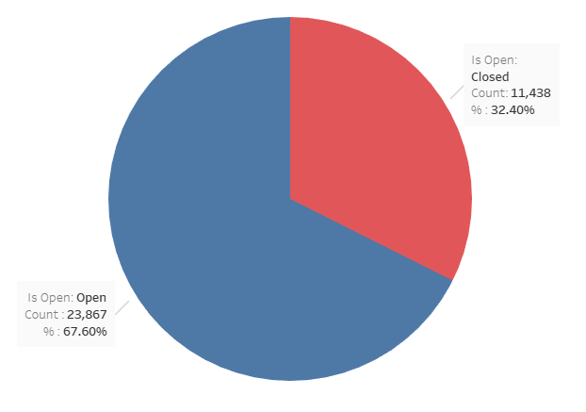


Target Variable "Is_Open"
1=Is Open
0=Is Not Open (or Closed)
67.60% of the target variable represent open restaurants, while 32.40% represent closed restaurants

Slide 21
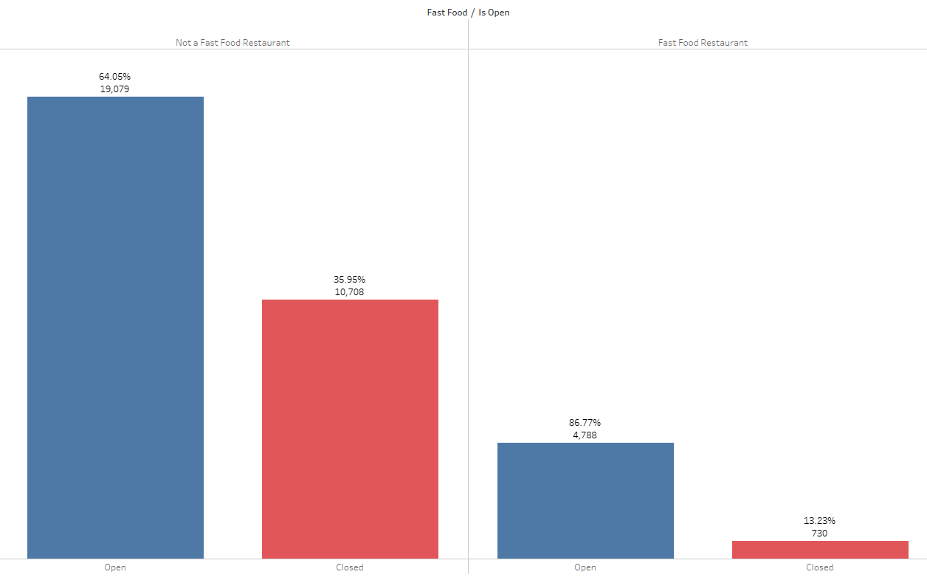


Fast Food
There are 5,518 (15.63%) fast food restaurants in the dataset while 29,787 (84.37%) of them are not fast food restaurants i.e., they are dining restaurants, café, buffet and so on.​
Almost a three times higher rate of closure in non fast food restaurants than in fast food restaurants.

Slide 22
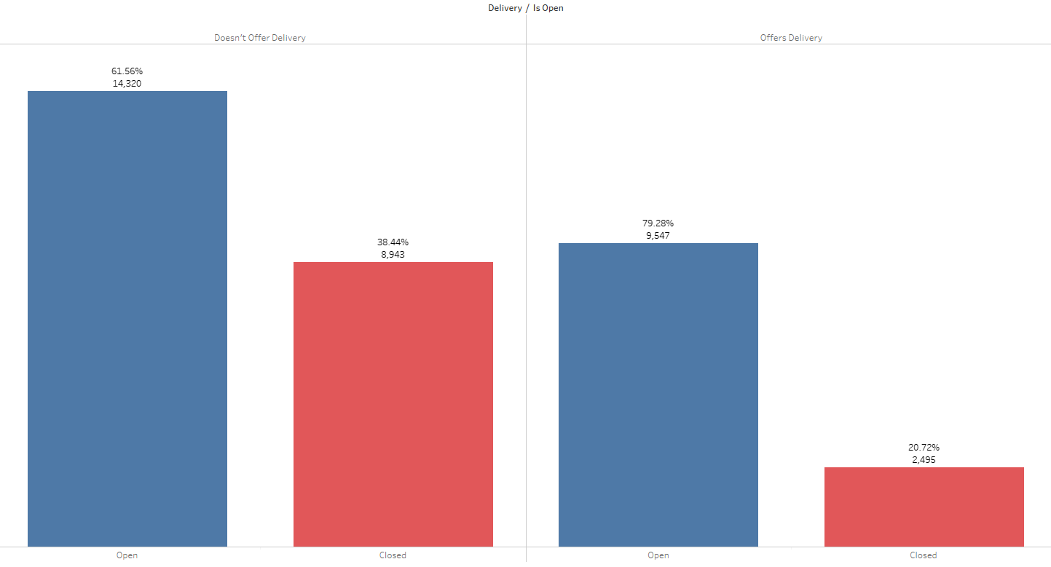


Delivery
That 20.72% of restaurants that offer delivery are closed (12,042 total delivery restaurants) while 38.44% of restaurants that do not offer delivery are closed (23,263 total non-delivery restaurants).
Delivery services are a popular dining option with U.S. consumers, as a November 2016 survey found that 20 percent of respondents use food delivery at least once a week.

Slide 23
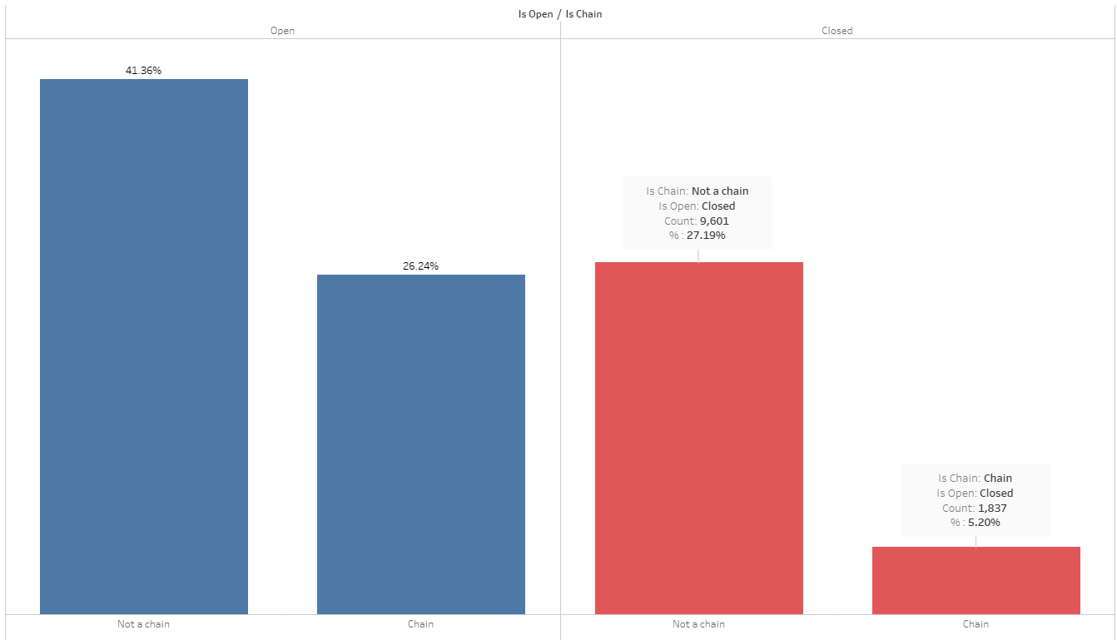


Chain Restaurants
There are 11,102 (31.45%) chain restaurants and 24,203 (68.55%) restaurants that are not classified as chain restaurants. 5.20% of closed restaurants are part of a chain and 27.19% are not.
"Large chains have the resources to ride out a protracted shutdown, but independent restaurants” find it harder to survive in same climate (Severson & Yaffe-Bellany, 2020).

Slide 24
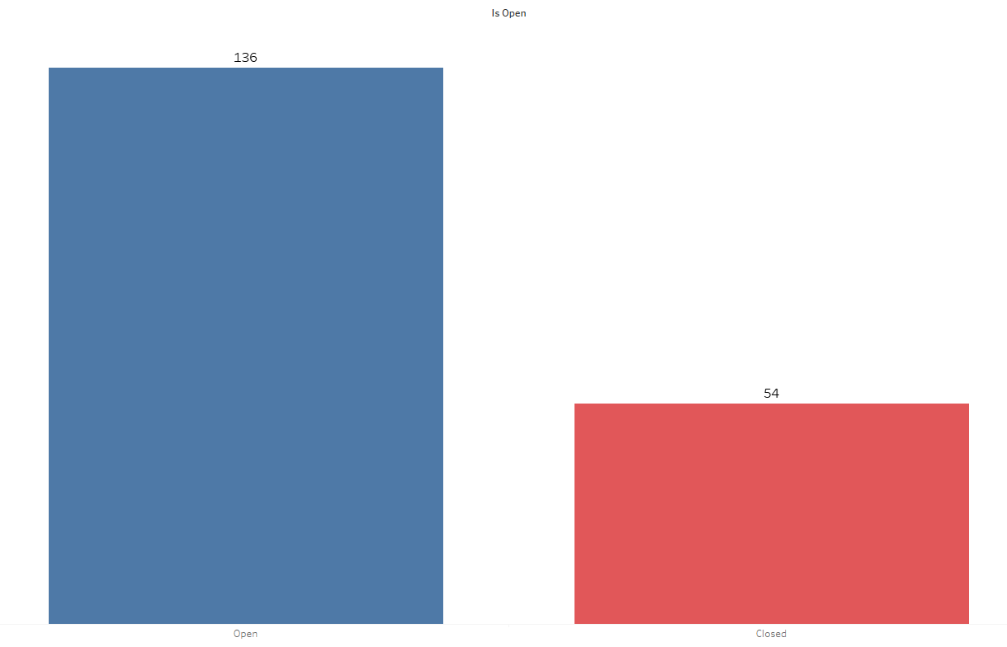


Average Reviews
The average number of reviews open restaurants have is 136 and the average for closed restaurants is 54 reviews

Slide 25
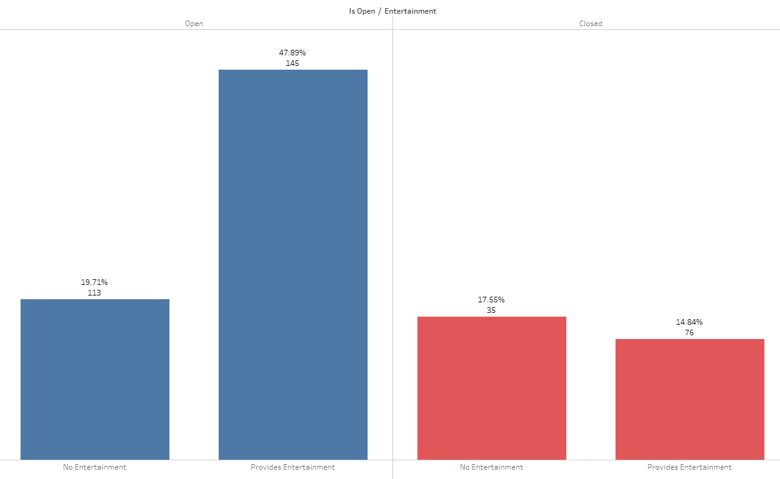


Entertainment and Reviews
In the dataset, 22,149 (62.74%) restaurants offer one or more forms of entertainment such as Background Music, Live Music, Jukebox and karaoke while 13,156 (37.26%) restaurants do not offer any entertainment.
There is a higher rate of closure in restaurants that do not provide entertainment. Experiences such as background music and other forms of entertainment are statistically significant predictors of satisfaction and repeat patronage (DiPietro 2016).
The closed restaurants have a lower number of reviews than restaurants that are open. This emphasizes the importance of reviews to the success of a restaurant.

Slide 26
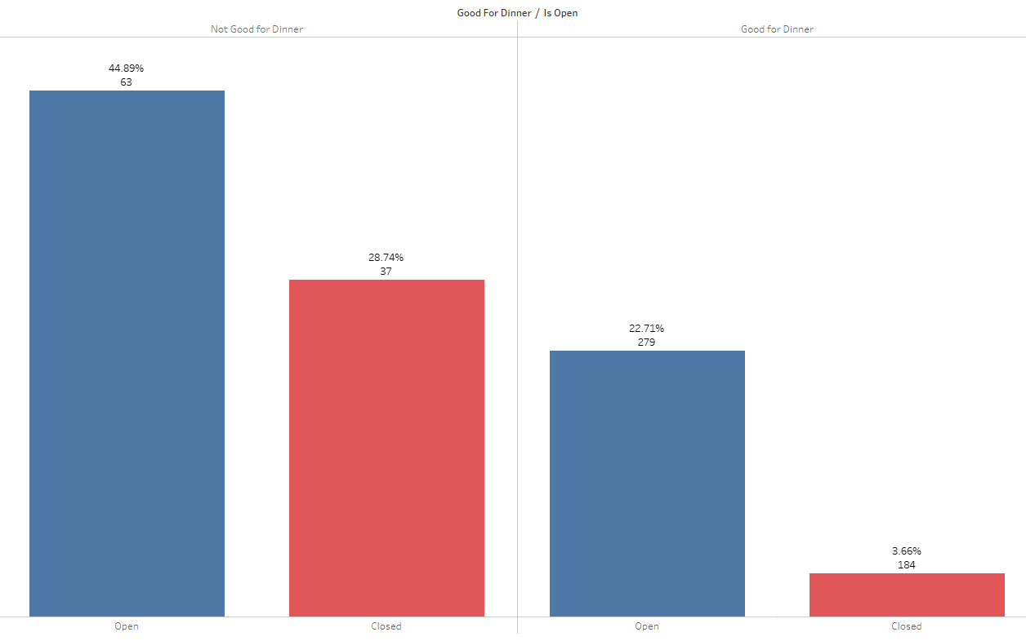
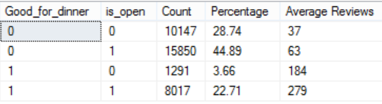
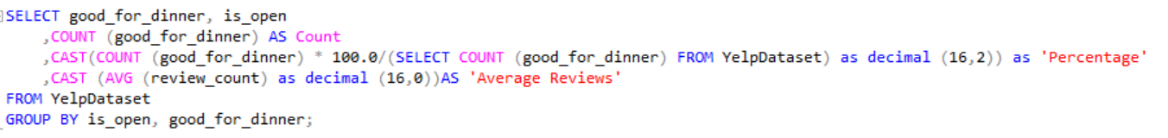
Good for Dinner and Reviews
There 25997 (73.64%) restaurants that are not good for dinner and 9308 (26.35%) that are good for dinner
There is a lower rate of closure for restaurants that are good for dinner.
Average reviews count is high for restaurants that are good for dinner

Slide 27
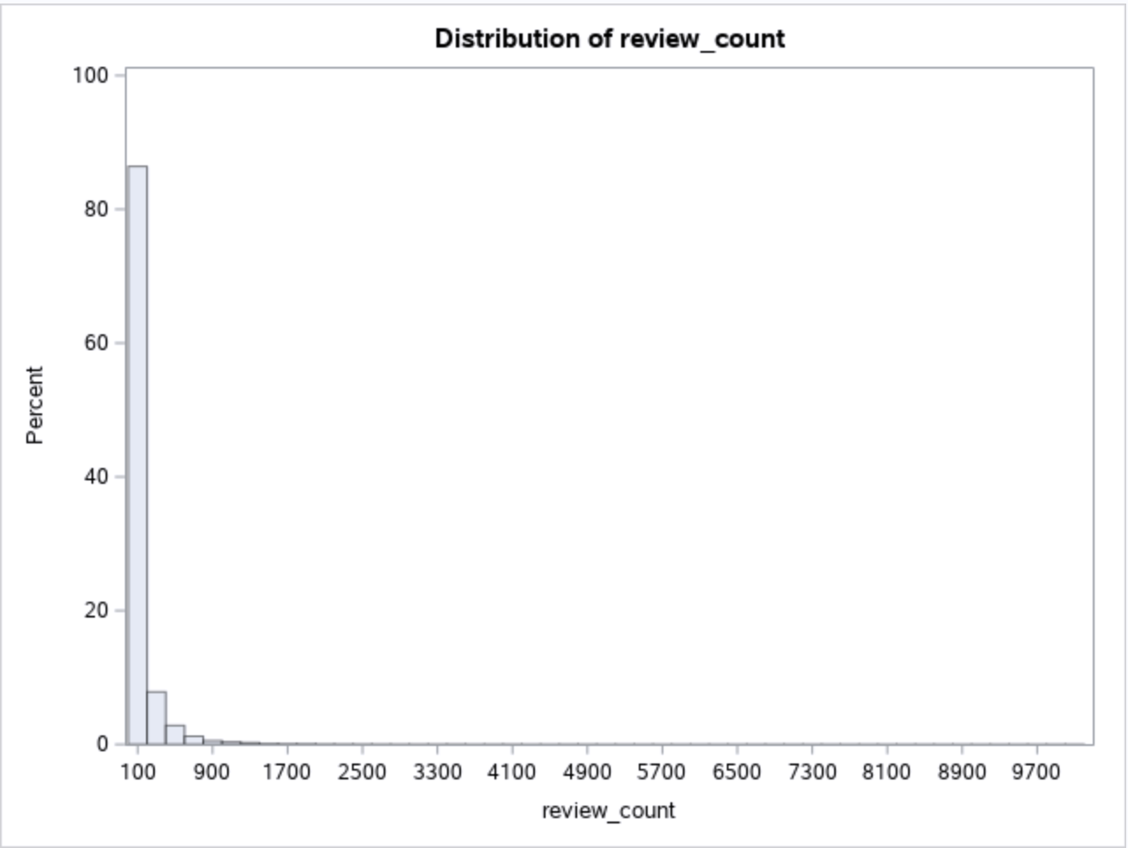
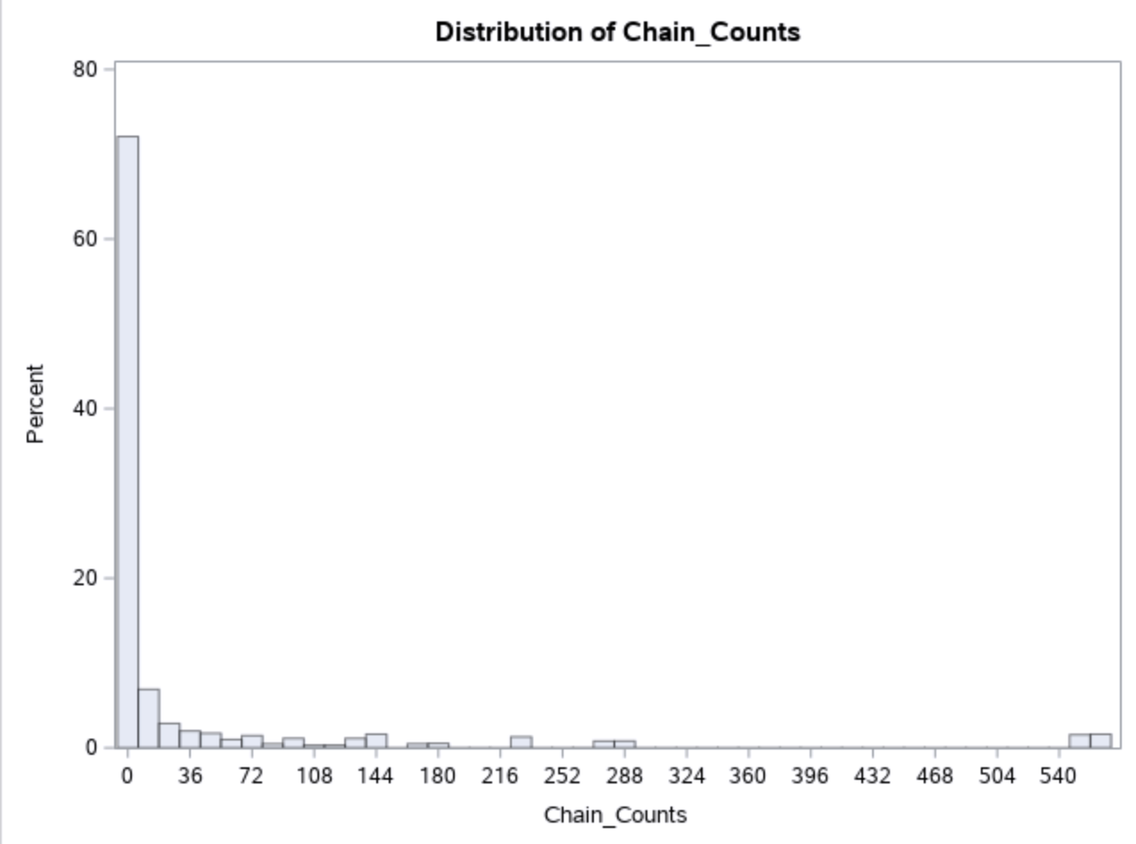
Distribution of Review Count and Chain Count

Slide 28
Transformation of Review Count and Chain Count
Variable Name | Mean | Std. Dev | Missing | Minimum | Maximum | Skewness | Kurtosis
Chain_Counts | 39.11432 | 109.321 | 0 | 1 | 568 | 3.752594 | 14.03053
Review_Count | 109.6016 | 259.9702 | 0 | 3 | 9264 | 10.99932 | 223.7574
Variable Name | Mean | Std. Dev | Missing | Minimum | Maximum | Skewness | Kurtosis
LOG_Chain_Counts | 1.731068 | 1.655816 | 0 | 0.693147 | 6.34388 | 1.494342 | 0.884064
LOG_Review_Count | 3.664527 | 1.410104 | 0 | 1.386294 | 9.133999 | 0.305811 | -0.56394

Slide 29
Regression Analysis

Slide 30

Stepwise Selection Regression
Variables Selected for the final model
Credit_ card | Reservations | Wifi | Stars
Delivery | Takeout | Wheelchair_access | LOG_review_ count
Entertainment | Alcohol | Price_Range | Noise_Level
FastFood | Good_for_ breakfast | Table_service | Happyhour
Is_chain | Good_for_ dinner | Parking | LOG_chain_ counts
Kid_ friendly | Good_for_ lunch | State
All 23 variables were selected
The Validation Misclassification rate is 0.199909
The model is 80.01% accurate
1332
3523
2197
10601
False Negative
True Negative
False Positive
True
Positive

Slide 31
Stepwise Selection Regression
Odds Ratio Estimates
LOG_Chain_ Counts 1.847
For each additional restaurant of a chain, the odds of staying open change by a factor of 1.847, or an 84.7% increase.
LOG_Review_Count 2.174
For each additional review, the odds of staying open is 2.174 higher.
Stars 1.337
For each additional unit of star, the odds of staying open changes by a factor of 1.337, or a 33.7% increase.
Entertainment 0.259
For restaurants without entertainment, the odds of staying open are 0.259 times or 74.1% lower than the odds of staying open for restaurants with entertainment.
Good_for_dinner 0.518
For restaurants that are not good for dinner, the odds of staying open are 0.518 times or 48.2% lower than the odds of staying open for restaurants that are good for dinner.

Slide 32
Conclusion and Recommendations

Slide 33

Conclusion
The 6 most importance variables for predicting restaurant closure according to the Regression analysis include:
Review Counts (the number of online reviews that each business has received)
Is_Chain (Indicating if the restaurant is a chain or not)
Chain Counts (count of all restaurants that are a part of the same franchise and have the same name)
Entertainment (Indicating if the restaurant provides entertainment or not)
Good_for_dinner (Indicating if the restaurant is good for dinner or not)
Stars (Indicating the start rating of the restaurant out of 5)

Slide 34

Recommendations
Independent restaurants at risk of closing can expand their business in order to grow in different locations or join a franchise to avoid closure. If this is not feasible, restaurants can also adopt the following recommendations.
Restaurants should provide entertainment such as background music, live music and TV (DiPietro, 2016) or improve the existing ones.
Promotions could be put in place to encourage customers to leave reviews and star ratings on yelp after visiting the restaurant. ("The restaurant owner who asked for 1-star Yelp reviews", 2020).
Restaurants that experience low traffic at dinner time and are considered "not good for dinner" can tailor their menu options to best suit customer needs.

Slide 35
References
Ames, M., and G. Berle. n.d. What are the major reasons for small business failure? US Small Business Administration. http://www.sba.gov/content/what-are-major-reasons-small business-failure (accessed October 2, 2011).
DiPietro, R. (2016). Restaurant and foodservice research. International Journal of Contemporary Hospitality Management, 29(4), 1203 1234.doi:http://dx.doi.org.vortex3.uco.edu/10.1108/IJCHM-01-2016-0046
Gagić, S., Tešanović, D., & Jovičić, A. [2013]. The vital components of restaurant quality that affect guest satisfaction. Turizam, 17(4), 166-176
McDonnell, S., 2020. What Percentage of Sales Are from Drive Through Windows at Fast Food Restaurants? [online] Small Business - Chron.com. Available at: <https://smallbusiness.chron.com/percentage-sales-drive-through- windows-fast-food-restaurants-75713.html>

Slide 36
References
McLynn, K. (2018, August 22). Total US Restaurant Count Stands At 660,755 in Spring 2018. Retrieved March 21,2020, from https://www.npd.com/wps/portal/npd/us/news/press releases/2018/total-us-restaurant-count-at-660755-in- spring-2018-a-one-percent-drop from-last-year-reports-npd/
Parsa, H. G., Self, J. T., Njite, D., & King, T. (2005). Why restaurants fail. Cornell Hotel and Restaurant Administration Quarterly, 46(3), 304-322. Retrieved from http://vortex3.uco.edu/ login?url=https://search-proquestcom. vortex3.uco.edu/docview/209705978?accountid=14516
Severson, K., & Yaffe-Bellany, D. (2020). Independent Restaurants Brace for the Unknown. Nytimes.com. Retrieved 16 July 2020, from https://www.nytimes.com/2020/03/20/dining/local-restaurants-coronavirus.html.
Wrulich, M., Hirschberg, C., Rajko, A., & Schumacher, T. (2020). McKinsey. McKinsey&Company. Retrieved from https://www.mckinsey.com/industries/technology-media-and telecommunications/our-insights/the-changing- market-for-food-delivery#

Slide 37

Questions and Answers

Slide 38


Thank You!

